Slide 1
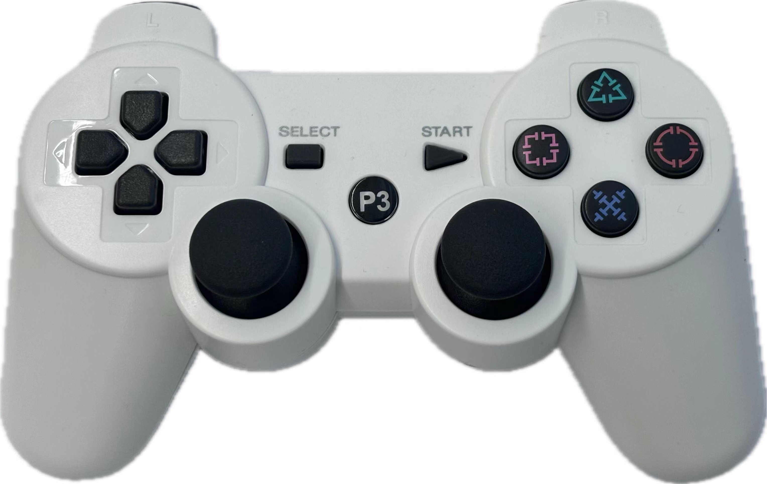
L1: Quick Release L2: Movement Speed Fast
L1: Reset Position L2: Movement Speed Slow
Shooter
Up
Claw Up
Open
Claw
Close
Claw
Shoot
Fast
Shoot
Slow
Stop
Moving
Shooter
Down
Claw Down
Forward
Shift
Left
Shift
Right
Turn
Left
Turn
Right
Backwards
Stop
Moving

